Slide 1
Project Title
Software Defined Network (SDN) Intrusion Detection Using Machine Learning
Name | ID
Muhammad Zawad Mahmud | 1931401042
Samiha Islam | 1931393642
Md. Solayman Hossain | 1931565042

Slide 2
Background
Software-defined networking (SDN) is a networking model where software-based controllers are used to connect to network's underlying hardware architecture and control traffic.
It is one of the most popular models currently. As a result hackers try to take control of it to gain confidential information.
In 2000, Yahoo was the first victim of an attack and in the same date also it recorded its first ever attack publicly. At the present time, web services and social websites are target of this attackers.
Machine learning, a form of artificial intelligence (AI) can be used to predict outcomes very accurately. For SDN also machine learning can play part by predicting attacks in an early stage and prevent data lose.

Slide 3
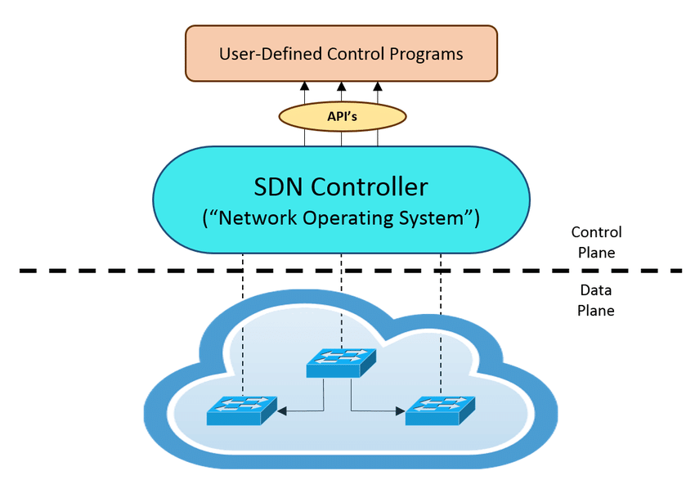
Block Diagram of SDN

Slide 4

What problem to be solved?
SDN, one of the most populist networking model is not risk free.
It is used by many big companies and government sectors.
Hackers try to take control of it in order to get confidential information of big companies or even government sectors.
As a result, many companies or even people of a certain countries information can be gained and be used to hamper a nation’s security.

Slide 5
How the problem will be solved
As discussed earlier, SDN is not risk free.
Many information can get into wrong hand without even the owner realizing it.
As it is used by big companies and even government sectors, an entire nation’s security will be at stake.
However if the attack can be predicted early than this data lose can be prevented.
Machine learning algorithms like Random Forest, Decision Tree can help to predict an attack. Even if not early at least it can predict in an early stage. As a result many data lose can be prevented.

Slide 6
What was done?
We have implemented four machine learning models (Random Forest, Decision Free, Gradient Boosting and Ada Boosting) into our database collected from Kaggle.
We got 99.38% accuracy for Random Forest and 99.24% accuracy for Decision Tree, 99.72% for Gradient Boosting and 99.34% accuracy for Ada Boosting as shown in the above slides.
It concludes Gradient Boosting is the most accurate.

Slide 7
Random Forest(RF)
A random forest is a meta estimator that fits a number of decision tree classifiers on various sub-samples of the dataset and uses averaging to improve the predictive accuracy and control over-fitting
The random forest classifier can be used to solve for regression or classification problems.
The random forest algorithm is made up of a collection of decision trees, and each tree in the ensemble is comprised of a data sample drawn from a training set with replacement, called the bootstrap sample.

Slide 8
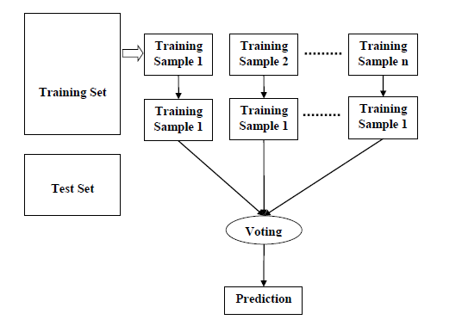
RF Block Diagram

Slide 9
Decision Tree (DT)
Decision Trees are a sort of supervised machine learning in which the training data is continually segmented based on a particular parameter.
Here the user will describe the input and the associated output.
Decision nodes and leaves are the two components that are used to explain the tree.
The choices or results are represented by the leaves.
The data is divided at the decision nodes.

Slide 10
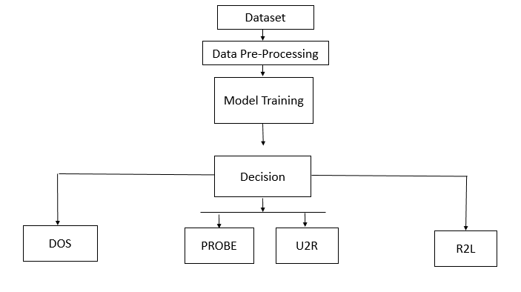
DT Block Diagram

Slide 11
Gradient Boosting
Gradient boosting classifiers are a group of machine learning algorithms that combine many weak learning models together to create a strong predictive model.
Decision trees are usually used when doing gradient boosting.
Gradient boosting models are popular now a days because of their effectiveness at classifying complex datasets.
It was recently been used to win many Kaggle data science competitions.

Slide 12
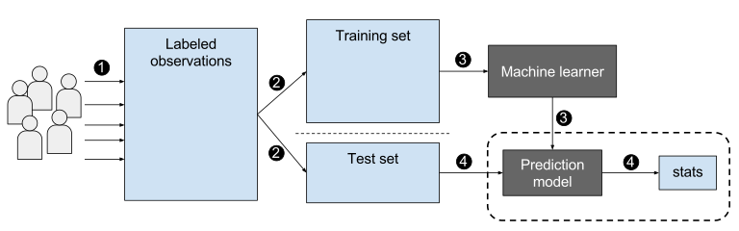
Gradient Block Diagram

Slide 13
Ada Boosting
AdaBoost also called Adaptive Boosting is a technique in Machine Learning used as an Ensemble Method.
The most common algorithm used with AdaBoost is decision trees with one level that means with Decision trees with only 1 split
These trees are also called Decision Stumps

Slide 14
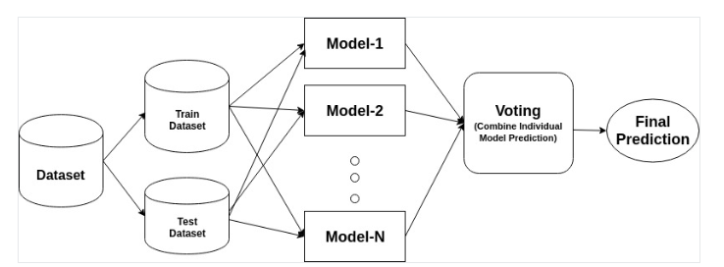
Ada Block Diagram

Slide 15

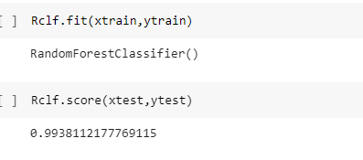
Results (Random Forest’s Accuracy)

Slide 16
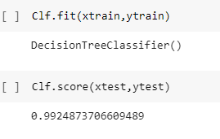
Results (Decision Tree’s Accuracy)

Slide 17
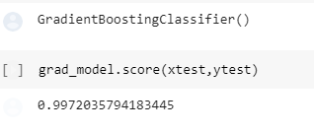
Results (Gradient Boosting’s Accuracy)

Slide 18
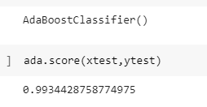
Results (Ada Boosting’s Accuracy )

Slide 19
Comparison
Four machine learning models was implemented. Those were: Random Forest, Decision Free, Gradient Boosting and Ada Boosting.
99.72% for Gradient Boosting, 99.38% accuracy for Random Forest, 99.34% accuracy for Ada Boosting and 99.24% accuracy for Decision Tree.
It concludes Gradient Boosting is the most accurate. The second best model was Random Forest, the third best model was Ada Boosting and the last one of the list was Decision Tree.

Slide 20
Tools Used For The Project
Google Collab
PyCharm
Jupyter NoteBook

Slide 21
Funding
There won’t be any funding required as it is a software based project.

Slide 22
Novelty
The project has better accuracy than the existing projects available for SDN intrusion detection.
We have also used two machine learning models Gradient bosting and Ada boosting which were not used earlier for intrusion detection.

Slide 23
Conclusion
SDN which is the short form of software defined network is one of the most populist model.
As it is becoming popular, unethical people are giving their eye on it.
Hackers plan to take control of the model and access many information.
As a result many people or even a nation’s security is at stake.
Our system will take help of various machine learning algorithm to predict the attack before it takes place or at earliest stage
As a result many data lose can be prevented.

Slide 24
Thank you

